Slide 1

Job Finding System

Slide 2
Team Details
Team - 1
Sarika Reddy Kota 15 Pallavi Arikatla 2 Himaja Joginipally 13

Slide 3
Motivation
To make job seekers way clear in fetching great opportunities of their interest and those jobs that match their profile through this project.

Slide 4
Data
For this application to work the data will be extracted from other job finding website like Indeed using web scraping. We will fetch the jobs data from “Indeed” using web scraping and then using the Node JS with the help of libraries like cheerios and Request. The Request library is used to make a HTTP request from Node JS application and the cheerios is used to get the data from the destination web page. This scraping data will be sent to frontend with the help of web API.
Source of data collection will ultimately be from job seekers.
Project target audience are students and job seekers.

Slide 5
Details
This application acts as an interface between job seekers and numerous profiles from different companies, which makes it easier for the seekers while job searching.

Slide 6
Scope of The Project
Web-Based Application.
Trends for the latest technologies.
Trends for the highly paid companies.
Scope of the technology for the future based on the current available openings in the market.

Slide 7
Work Flow
This project is to be implemented by using Angular in the front end and backend using express JS and Node JS. We will fetch the jobs data from “Indeed” using web scrapping and then using the Node js with the help of libraries like cheerios and Request. The Request library is used to make an HTTP request from the Node js application and the cheerios are used to get the data from the destination web page. This scrapping data will be sent to the frontend with the help of web API.

Slide 8
Application
The targeted user of this application is a Person who is in search of a job
The application can pick some keywords from the uploaded resume and Can find the related job posting and display them to the user.
The user can use this application when they are in search of a Suitable job, This application is deployed on the web browser.
In this application, The user can upload a resume from where some keywords will be picked and Depending on that Suitable job lists, Their location, and Annual pay will be shown. The user will be able to apply for that job if that suits his interest.
Indeed website is taken as reference and by using web scraping, Job postings will be displayed to the user

Slide 9
Tech Stack
Mongo DB- MongoDB is a cross-platform document-oriented database program. Classified as a NoSQL database program, MongoDB uses JSON-like documents with schema
Express JS- Express.js, or simply Express, is a web application framework for Node.js. It is designed for building web applications and APIs
Angular- Angular is a TypeScript-based open-source web application framework led by the Angular Team at Google and by a community of individuals and corporations.
Node JS- Node.js is an open-source, cross-platform, JavaScript runtime environment that executes JavaScript code outside of a web browser
AWS- Amazon Web Services is a subsidiary of Amazon that provides on-demand cloud computing platforms and APIs to individuals, companies, and governments, on a metered pay-as-you-go basis

Slide 10
Registration page, Login UI page.
Job Description, Career Advice
Validation columns for details.
Responsive UI.
Front-End

Slide 11
Express JS and Node JS.
Usage of several API’s.
A responsive user interface.
Back-End

Slide 12
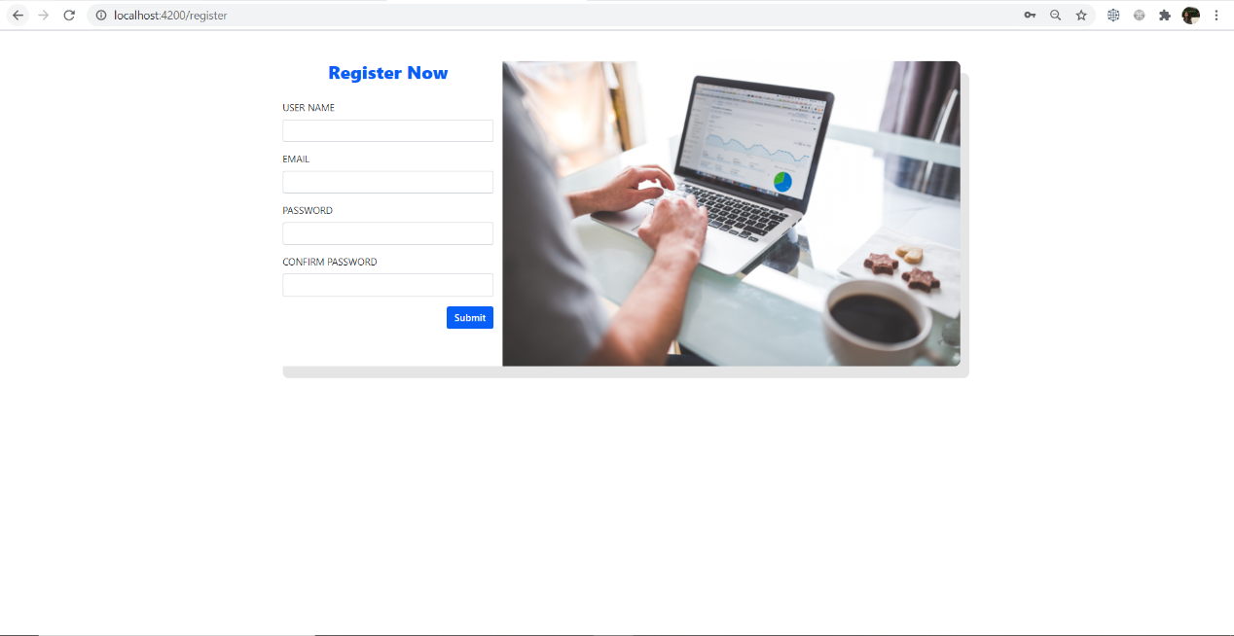
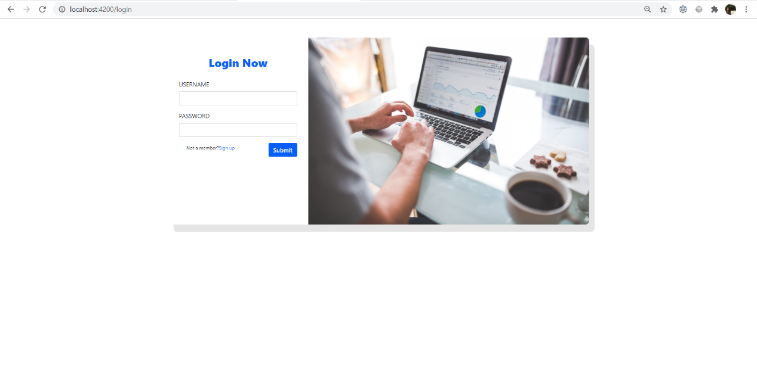
Working screens
Registration page:
Login page:

Slide 13
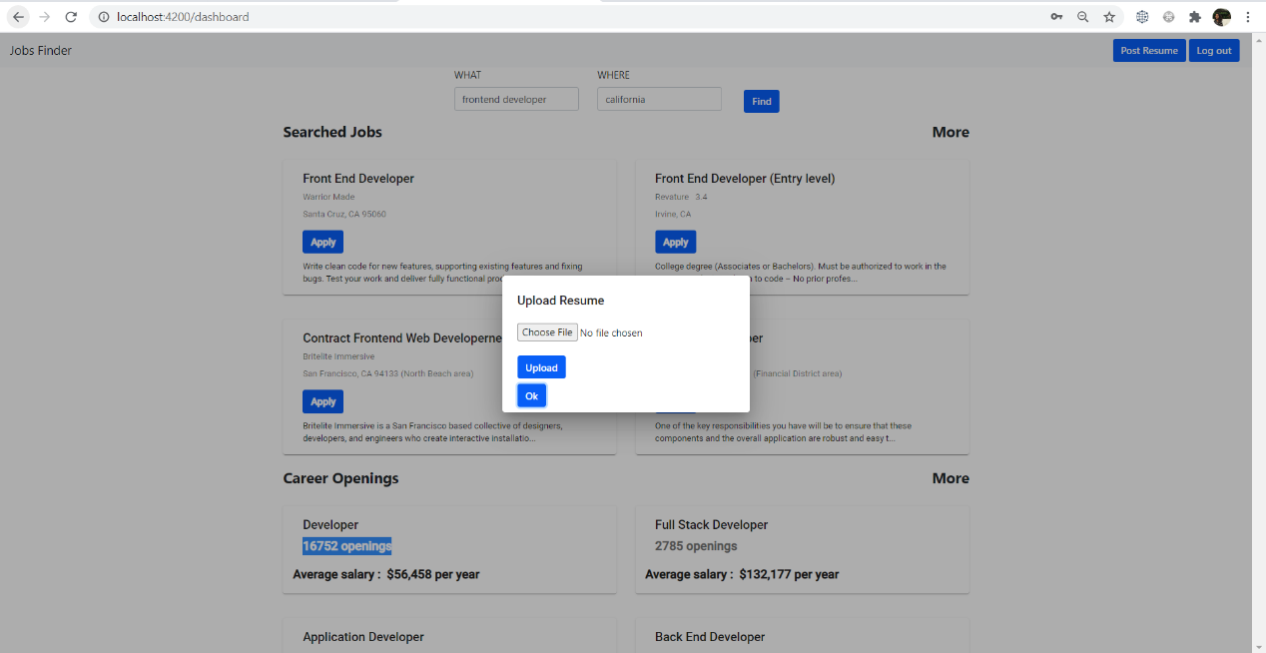
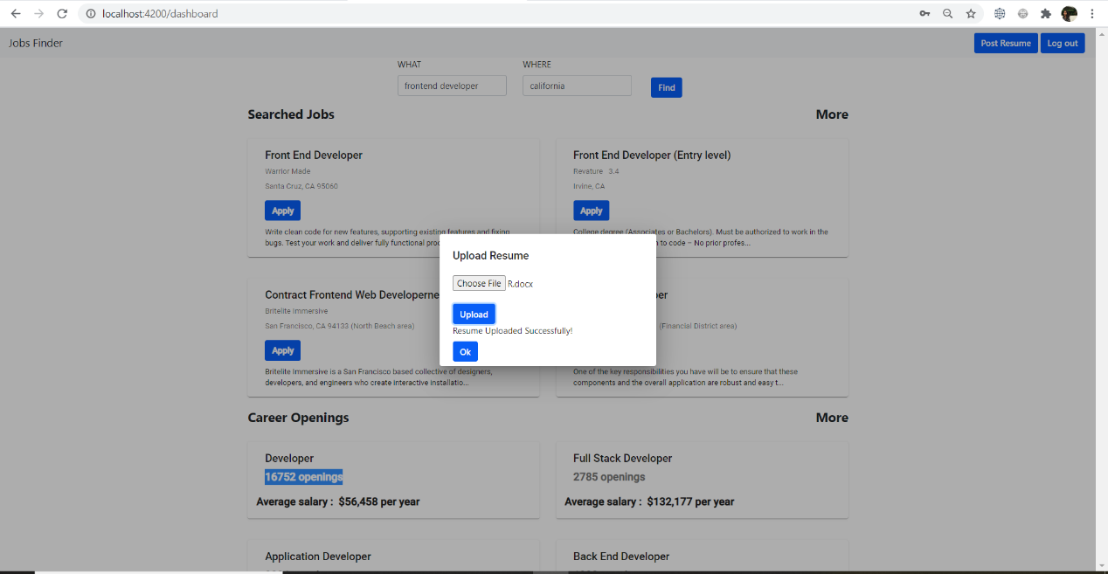
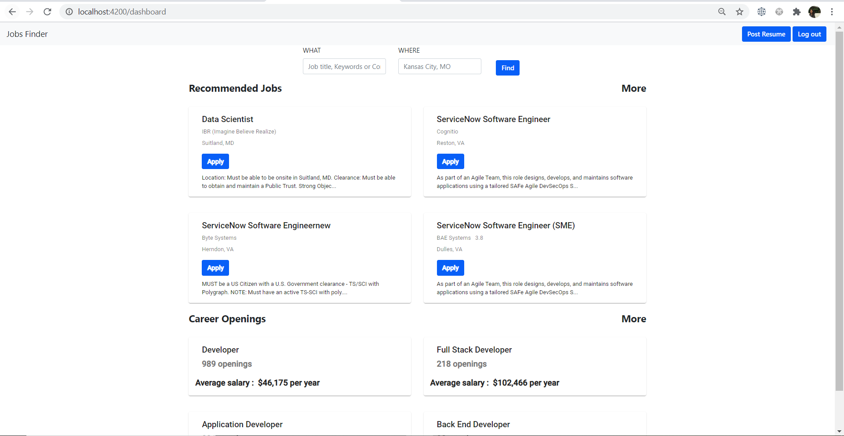
Working screens
Resume upload page
Resume uploaded
Recommendations for resume

Slide 14
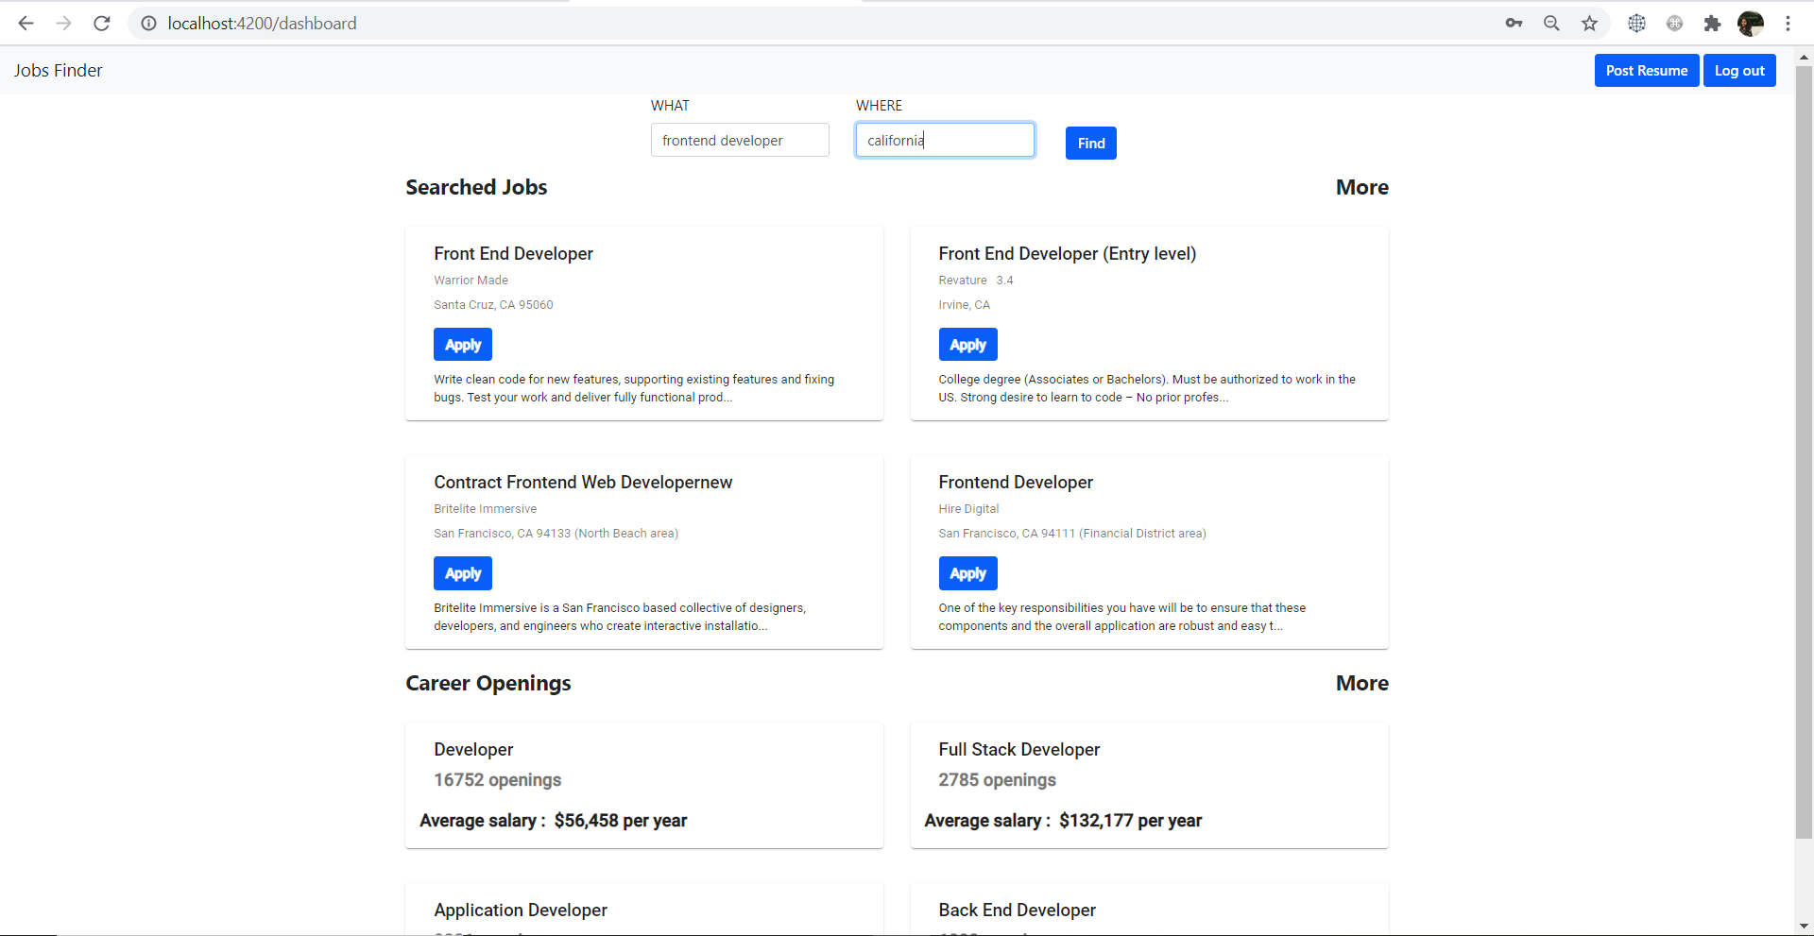
Working screens
Career path recommendations

Slide 15




Features
AUTHENTICATION FOR USERS
ANALYZING THE RESUME UPLOADED AND DISPLAYS THE JOBS THAT MATCHES THE PROFILE
CAN SEARCH THE JOBS BY PROVIDING THE JOB TITLE AND LOCATION DESIRED TO WORK
SHOWS THE OPENINGS AVAILABLE IN THE LOCATION SEARCHED

Slide 16
Responsibilities
Web scrapping, Web API creation in express, Career advice- Sarika Kota
Front-end Angular services, Styling, Responsiveness - Pallavi Arikatla
Job Description modal, Resume upload, documentation- Himaja Joginipally

Slide 17
References
https://www.indeed.com/companies?from=gnav-title-webapp
https://www.indeed.com/?from=gnav-acme--discovery-webapp
https://github.com/cheeriojs/cheerio
https://medium.com/bb-tutorials-and-thoughts/angular-understanding-angular-lifecycle-hooks-with-a-sample-project-375a61882478
https://www.indeed.com/career/salaries
https://angular.io/start https://expressjs.com/ https://www.tutorialspoint.com/internet_technologies/websites_development.htm https://www.indeed.com/jobs https://www.indeed.com/career/software-engineer/companies https://www.indeed.com/career/software-engineer/salaries

Slide 18

Any Questions…?

Slide 19

Thank You…

